Slide 1
Animals-10
Deep Learning Project Report

Slide 2
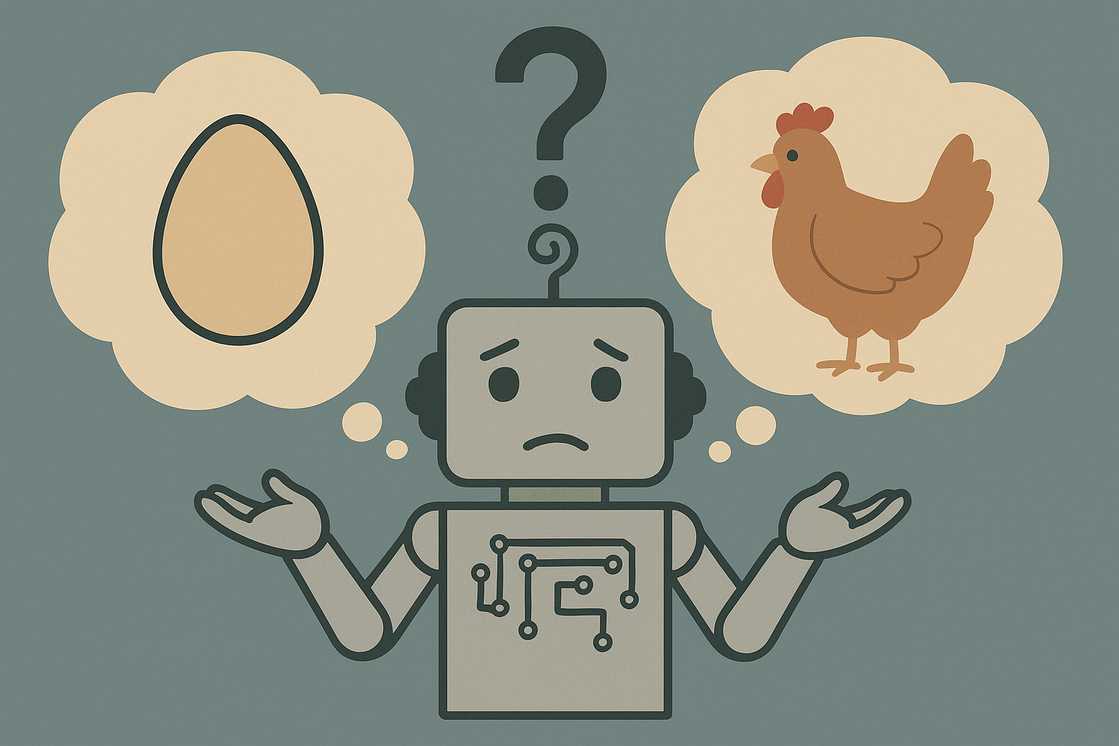
What came first?
🎯 Goal: Make machines "see" the way we do.

Slide 3
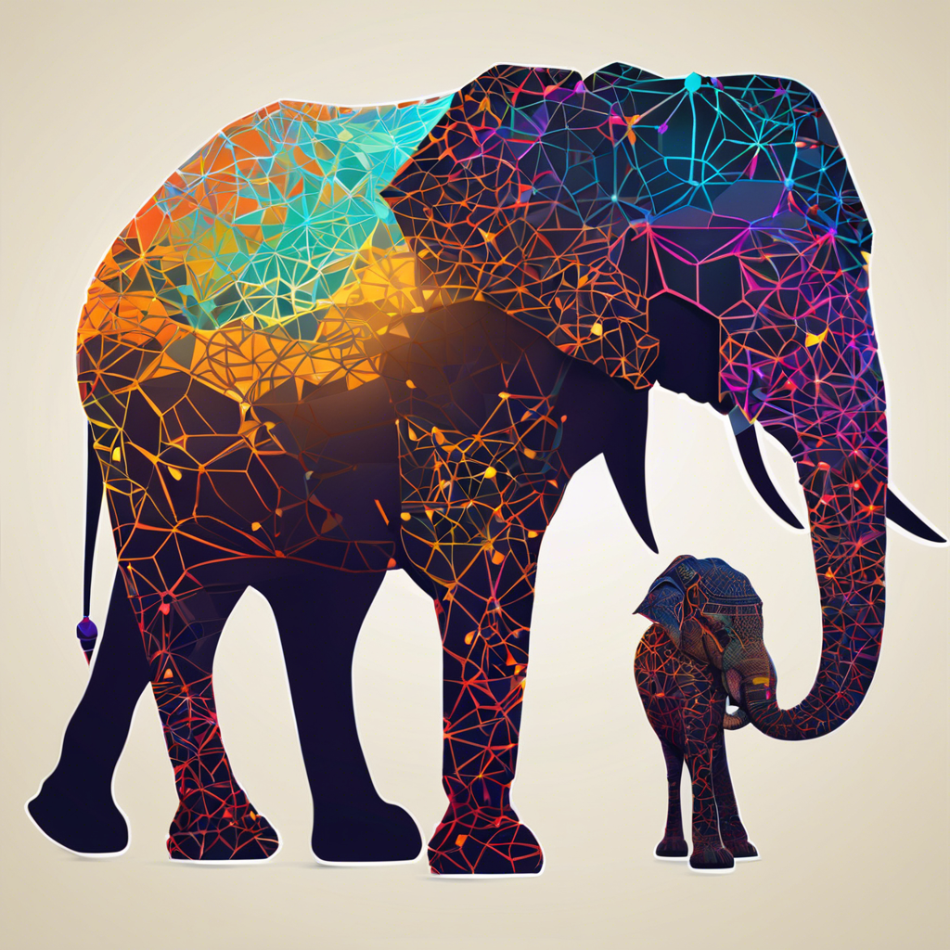
Dataset Chosen
Chosen dataset: Animals-10
Number of classes: 10
Number of images: ~28,000
Image dimensions: Varying, resized to 128x128

Slide 4
Overview of the Problem
Image classification
Custom CNNs
Transfer Learning

Slide 5


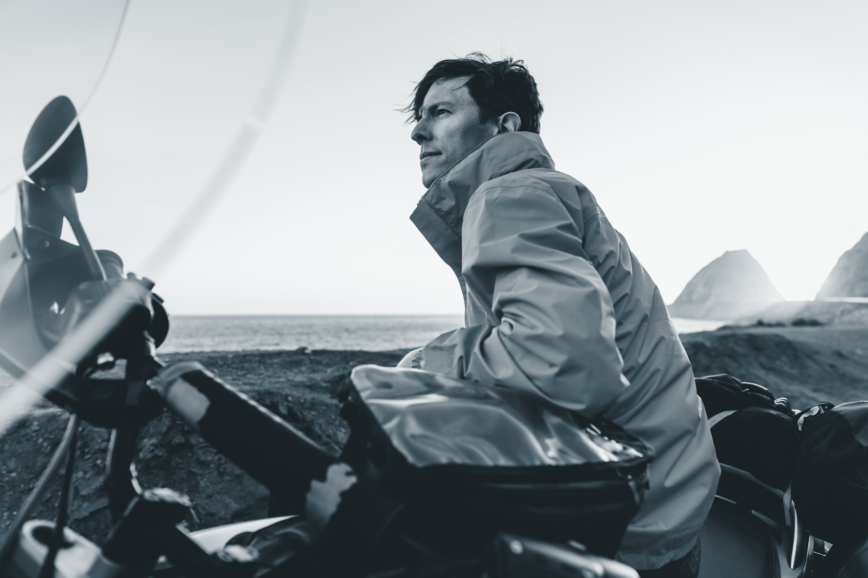
Data Pre-processing
Data Cleaning
Data Augmentation
Normalization / Standardization

Slide 6
Data Pre-processing
Workflow Diagram
Sample Images
Statistics

Slide 7
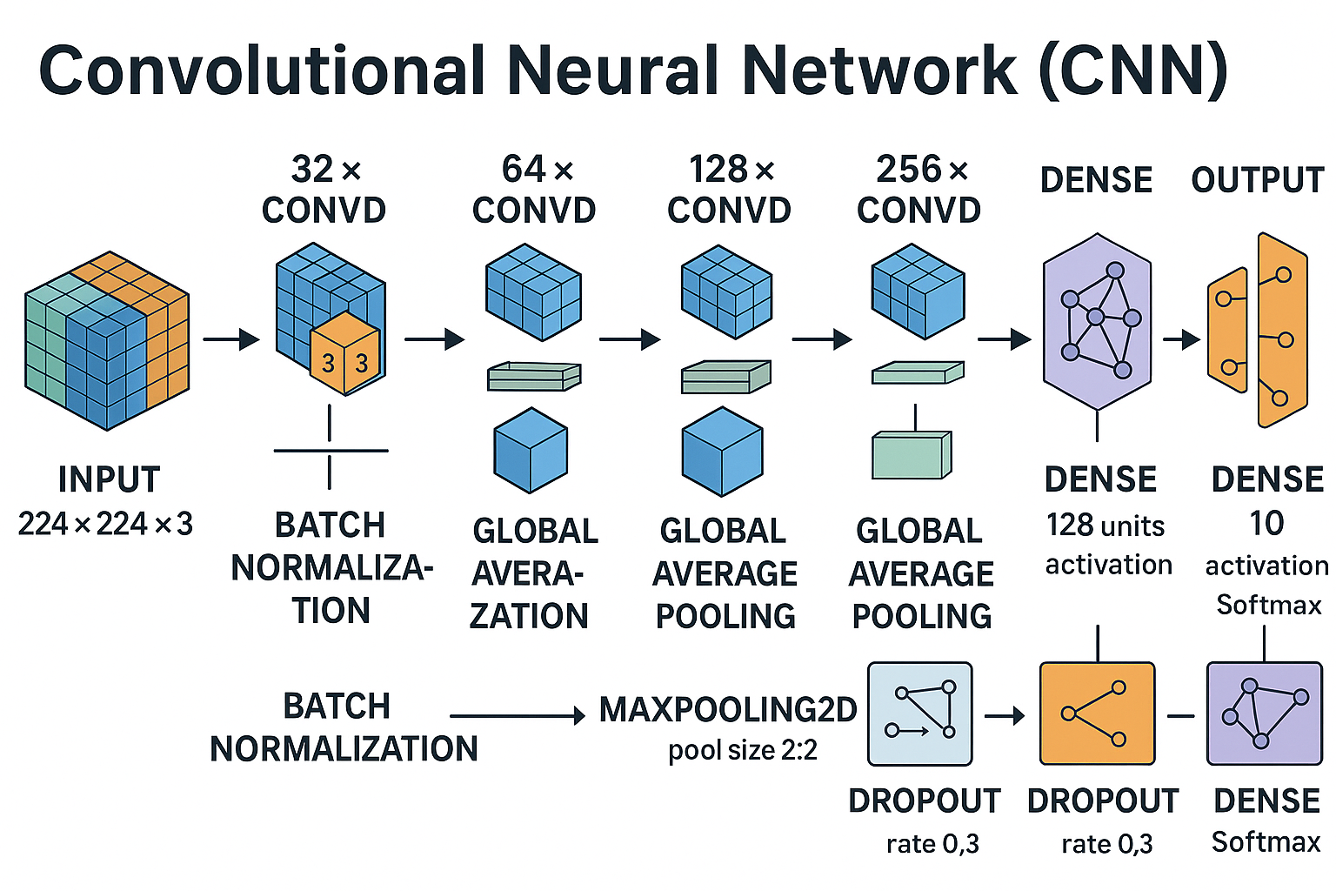
CNN Model Architecture
Custom-built deep CNN tailored for 224x224 RGB animal images
Consists of 4 convolutional blocks (Conv2D + BatchNorm + MaxPooling)
Feature extraction increases from 32 to 256 filters
GlobalAveragePooling + Fully Connected layers for classification
Dropout added to reduce overfitting

Slide 8
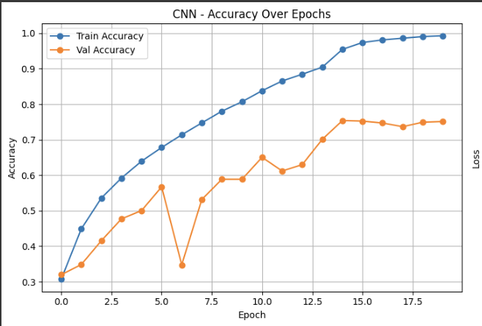
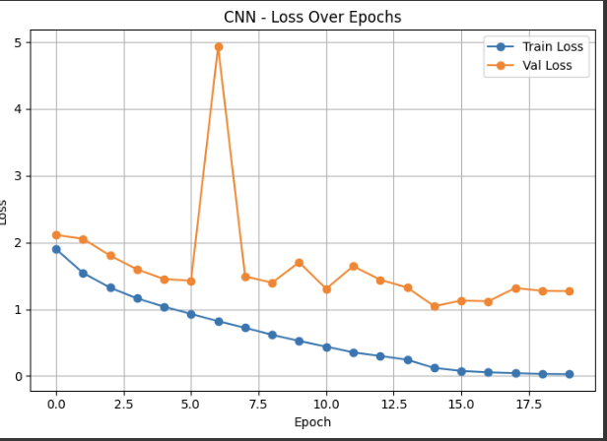
Training of the CNN Model
Model compiled with Optimizer: Adam (lr=0.001), Loss: Sparse Categorical Crossentropy.
Added EarlyStopping and ReduceLROnPlateau callbacks to reduce overfitting and improve generalization.
Trained for 30 epochs, class weights used to balance label frequencies.
Accuracy improved steadily, with a performance boost around epoch 15 and Learning rate dropped after epoch 14 after plateau.
Accuracy grew from 25% to 99%, val accuracy peaked at 75%

Slide 9
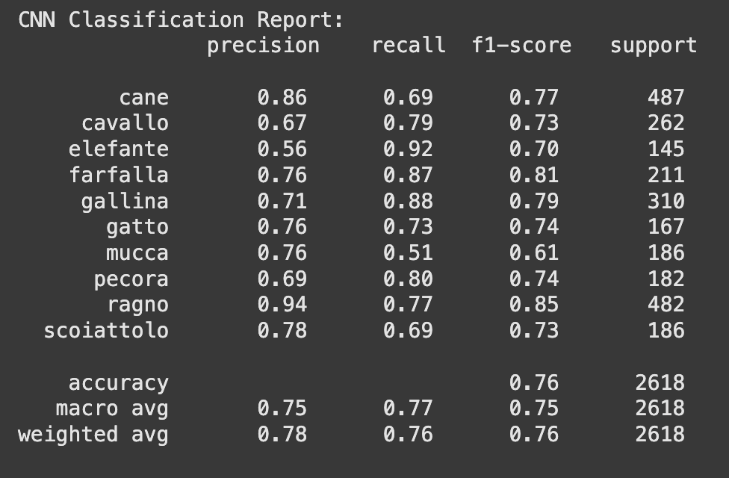
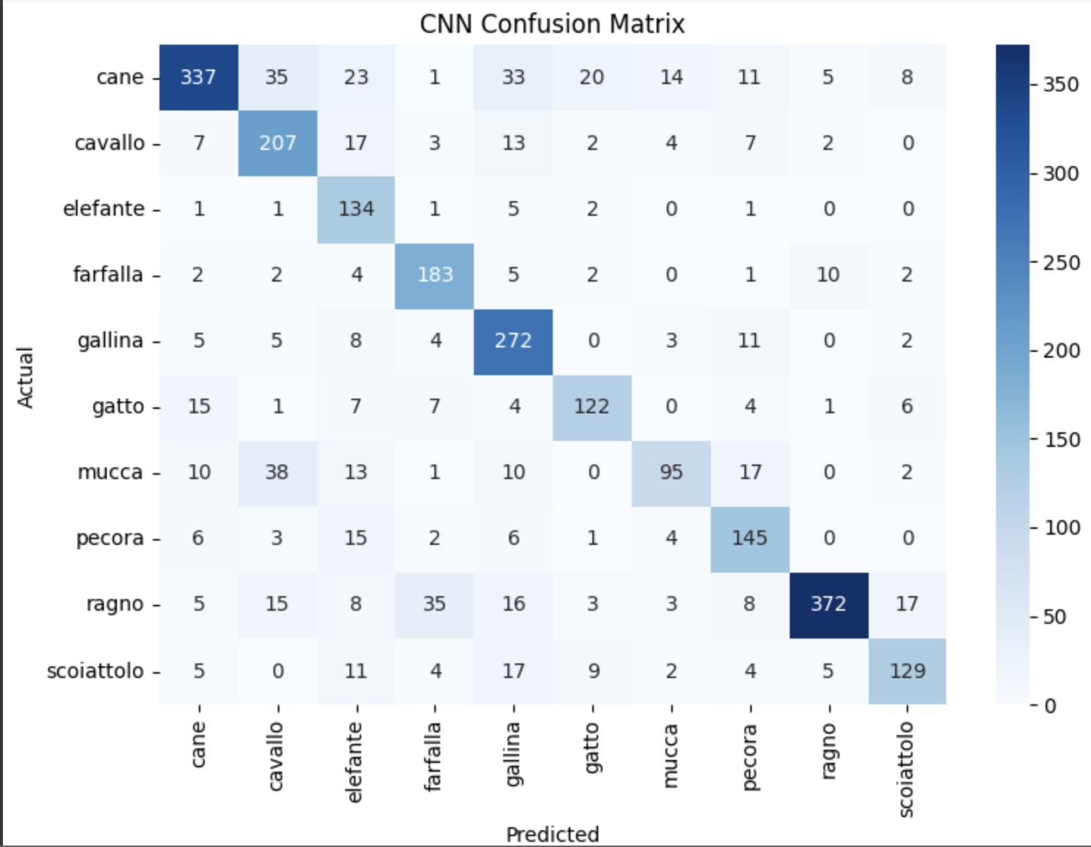
CNN MODEL EVALUATION
Test Accuracy: 77.5% on unseen animal images
Precision/Recall solid across most classes (especially "elefante")
Best class recall: 'elefante' (92%) – high sensitivity
Lower recall class: 'mucca' (51%) – needs improvement
Confusion matrix: shows decent class separation
Slight overfitting detected, mitigated with Dropout & Callbacks

Slide 10
🧠 Transfer Learning with ResNet50
Pretrained model: ResNet50 (trained on ImageNet)
Why ResNet50?
ResNet18, 34, 50, 101, 152
Deep architecture, strong generalization.
Modifications:
Removed top layers (include_top=False)
Added: 128 Neuron → Dropout(0.3)
Training Strategy:
Base frozen initially
Fine-tuned top layer on our Animal-10 dataset
💡 Boosted performance with less training time
CNN: Epoch 20
ResNet50: Epoch 7
Notes:
Key points:
Transfer Learning: Instead of training everything from scratch, you used ResNet50, a model already trained on millions of images (ImageNet).
Modification: You removed its last layers and added new ones for your 10 animals.
Training Strategy:
You froze the early layers to keep their powerful "knowledge."
You fine-tuned the new layers on your animal dataset.
Simple explanation:
"Instead of teaching the computer everything from the beginning, we used a model called ResNet50 that already knows a lot about images. We customized it for our animals. This saved time and improved performance."
Why ResNet50?
Deep architecture, residual connections, strong generalization.
Modifications:
Removed top layers (include_top=False)
Added: GlobalAvgPooling2D → Dense(128, ReLU) → Dropout(0.3) → Dense(10, softmax)
Training Strategy:
Base frozen initially
Fine-tuned top layer on our dataset

Slide 11
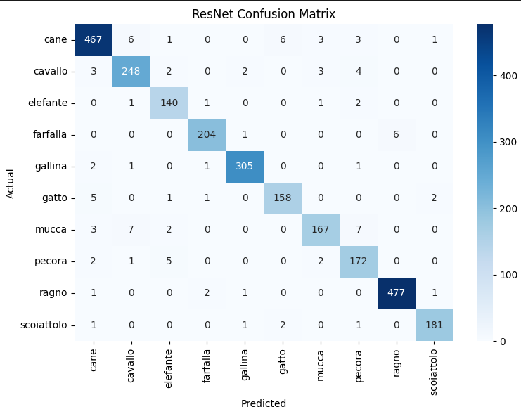
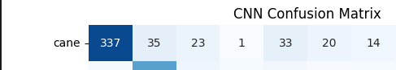
🧪 ResNet50 Evaluation
Test Accuracy: 96%
Precision/Recall strong across all classes
Best class recall: 'Spider' (99%)
Lower recall class: 'Cow' (90%)
Confusion matrix: shows minimal misclassifications
Balanced performance across all metrics
From 33 with CNN to 0 with ResNet
🧠 Insight: Transfer learning drastically improved performance on underrepresented classes.
Notes:
Luis here.

Slide 12
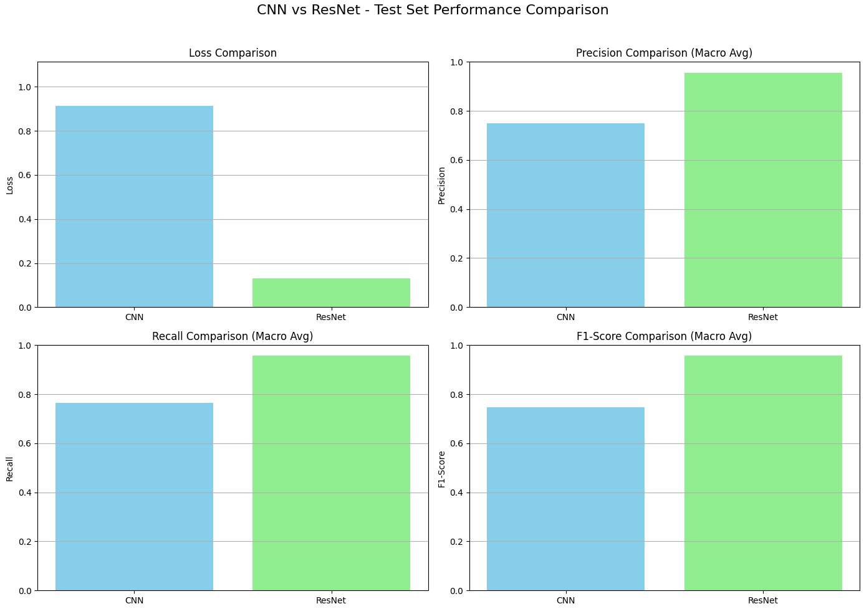
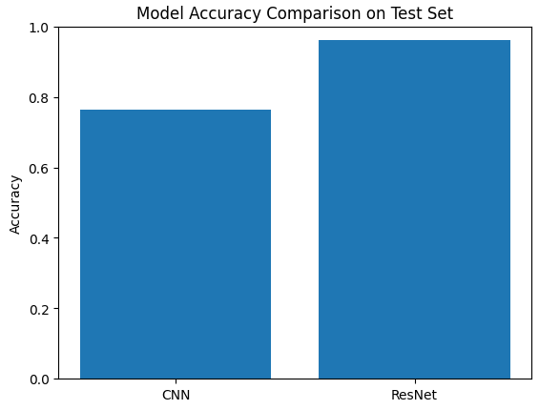
Notes:
Lower loss: ResNet generalizes better and learns more effectively.
Higher precision (fewer false positives): ResNet achieves ~0.96, while CNN is around 0.75.
Higher recall (fewer false negatives): ResNet has a recall close to 0.96, while CNN is lower (~0.77).
Higher F1-score (overall robustness): ResNet achieves near 0.96, while CNN is around 0.75.

Slide 13
✅ Project Recap & Outcomes
🧠 Goal: Classify animal images (10 categories)
⚙️ Models: Custom CNN + Transfer Learning with ResNet50
📈 Techniques: Preprocessing, Augmentation, Optimization
🏆 Outcome: High-accuracy model with robust generalization
🌐 Bonus: Web app for real-time classification
🎓 What we learned:
CNN architecture design
Transfer learning trade-offs
How hyperparameters affect training and overfitting.
The importance of data preprocessing
And much much more.

Slide 14
Thank you
Project 2: Deep Learning
Group 1:
Luis
Affiong
Nicholai

